Slide 1
Pharmacovigilance using social media..!
Saeed Ahmad Student of Data Science
FAST-National University of Computer and Emerging Sciences, Pakistan.

Slide 2
What is Pharmacovigilance..?
Pharmacovigilance is a process of dealing adverse effects of drugs.
Detection Assessment Understanding Prevention
Before availability of drugs in the market, Rigorous clinical studies are conducted but limited because of various factors, cost might be at top.

Slide 3
Why use of social media..?
Lots of fee data about almost everything.
Understand the audience.
Social data helps to create better content.
Collect reviews about drugs, dosage, usage duration, conditions, results and reactions.

Slide 4
Problems
World Health Organization(WHO) https://www.who.int/
Dying from a disease may be inevitable, dying from a medicine is unacceptable (WHO, 2005)
Almost, 60-70% of Adverse drug reaction (ADR) are preventable.
ADR related cost to the country may exceed the cost of the medications themselves.
Notes:
World Health Organization (WHO)

Slide 5
Motivation & Goals
Adverse drug reaction (ADR) https://en.wikipedia.org/wiki/Adverse_drug_reaction
Reduce the cost of Pharmacovigilance
Ensure safer drugs to the healthcare community ADRs
Early detection of reactions in situation.
Detection of drug usage frequency.

Slide 6
Country based Pharmacovigilance
Unique traditions and diets influencing reactions
ADRs may be associated with traditional or herbal remedies
ADRs to certain in particular ethnic groups
Manufactured & differ in ingredients or production

Slide 7
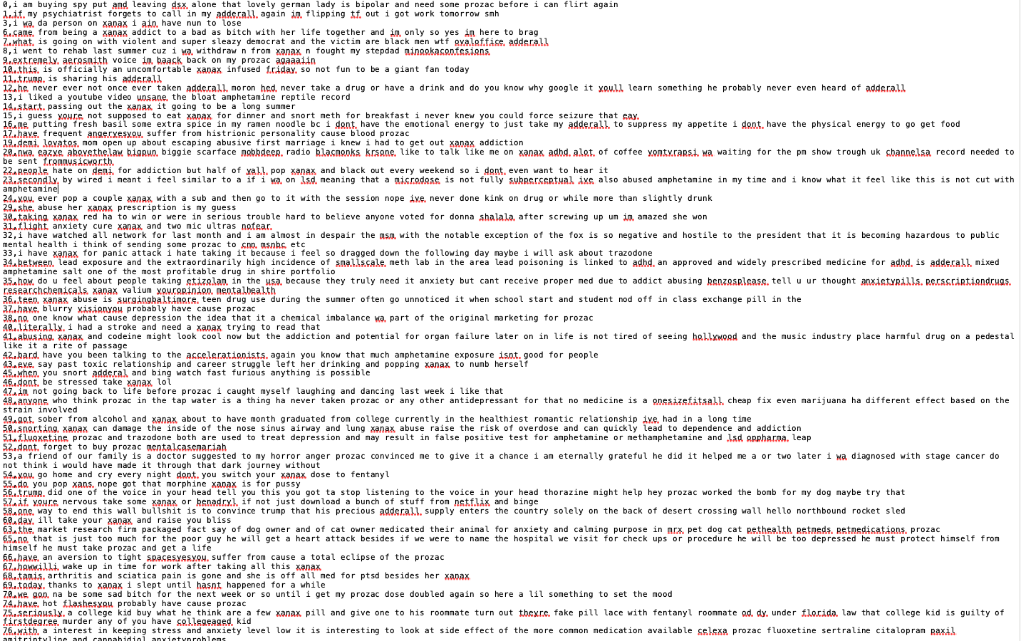

Slide 8
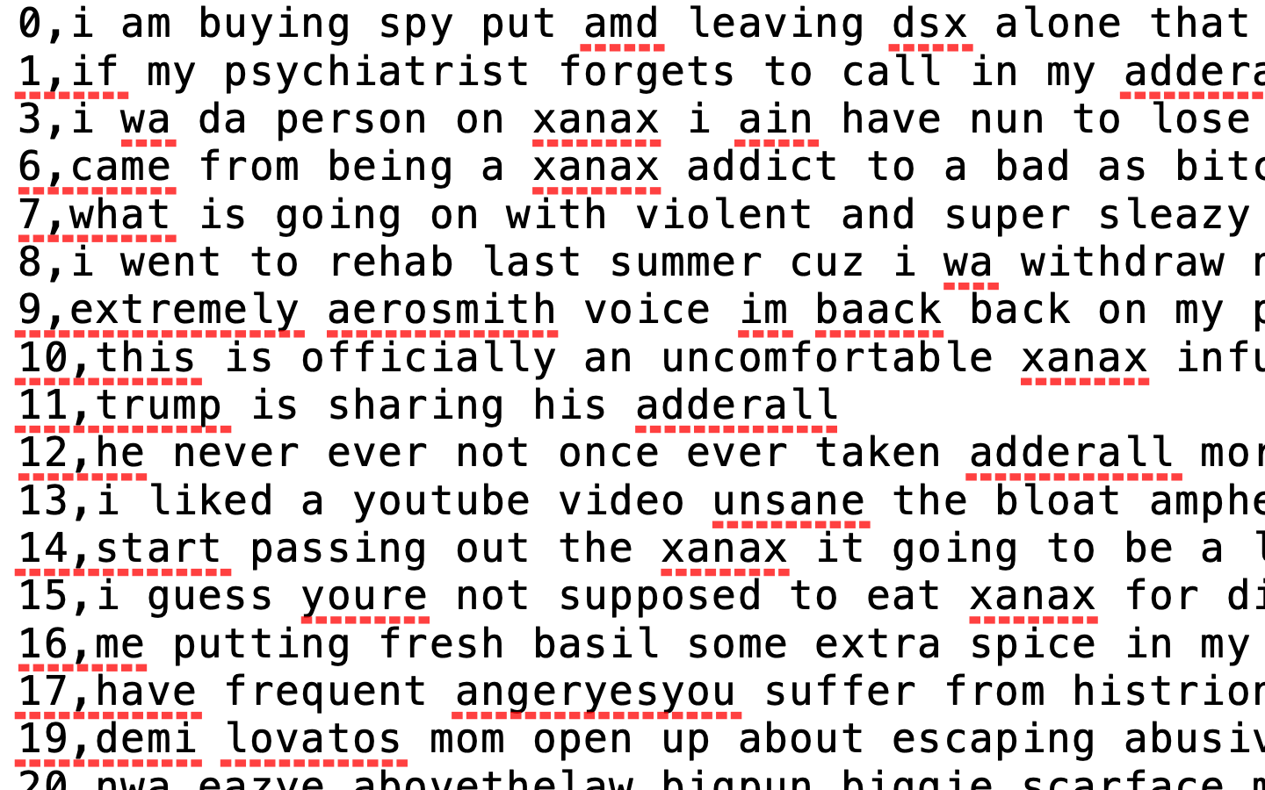

Slide 9
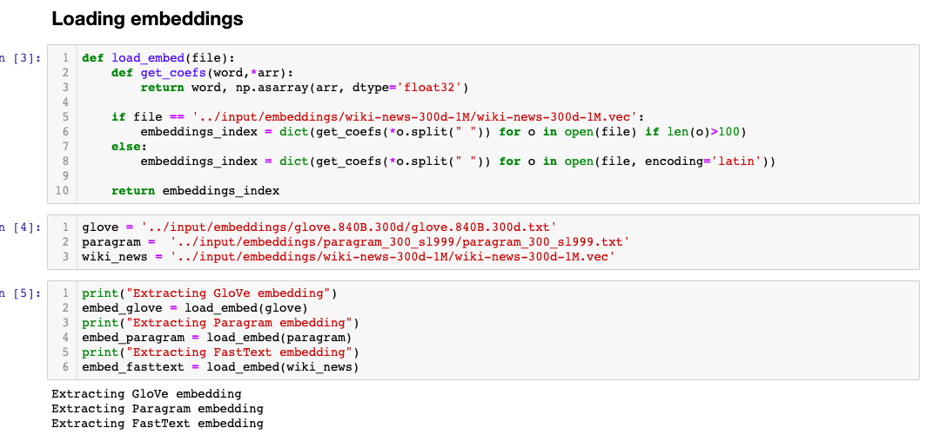
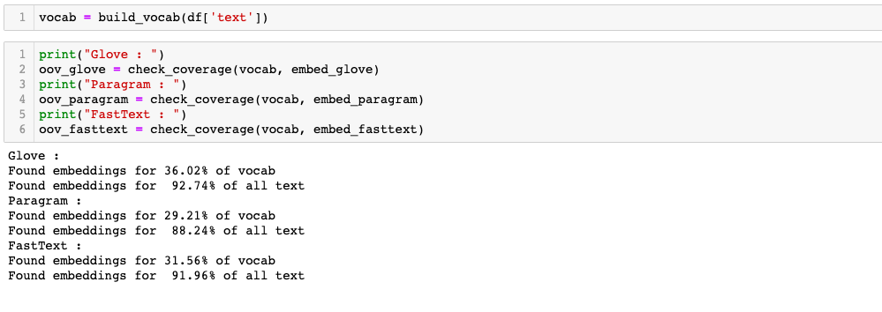

Slide 10
NLTK usage
To make a proper and meaningful split
Tokenize and steaming

Slide 11
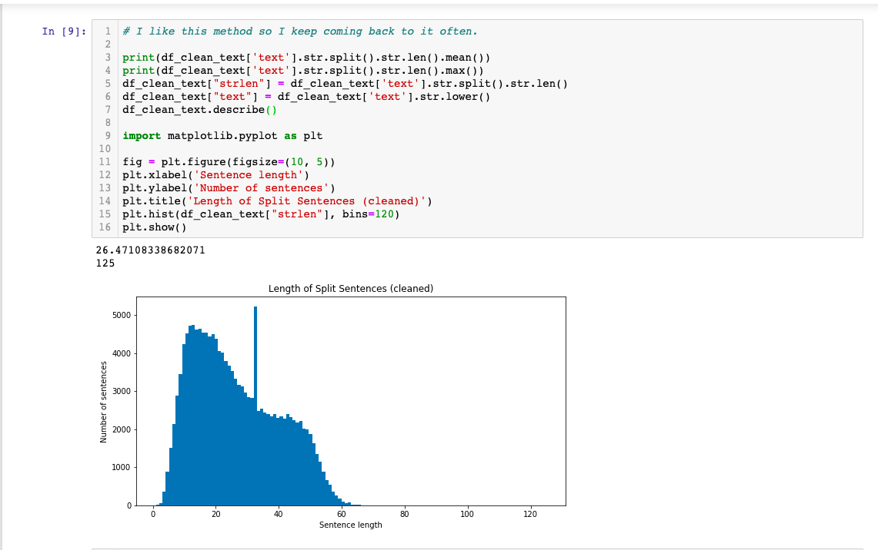

Slide 12
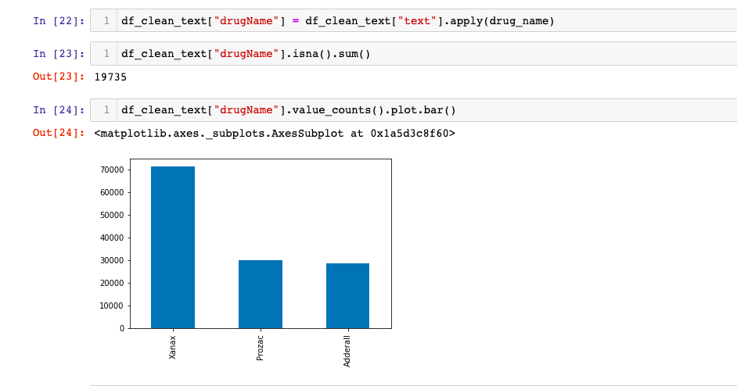

Slide 13
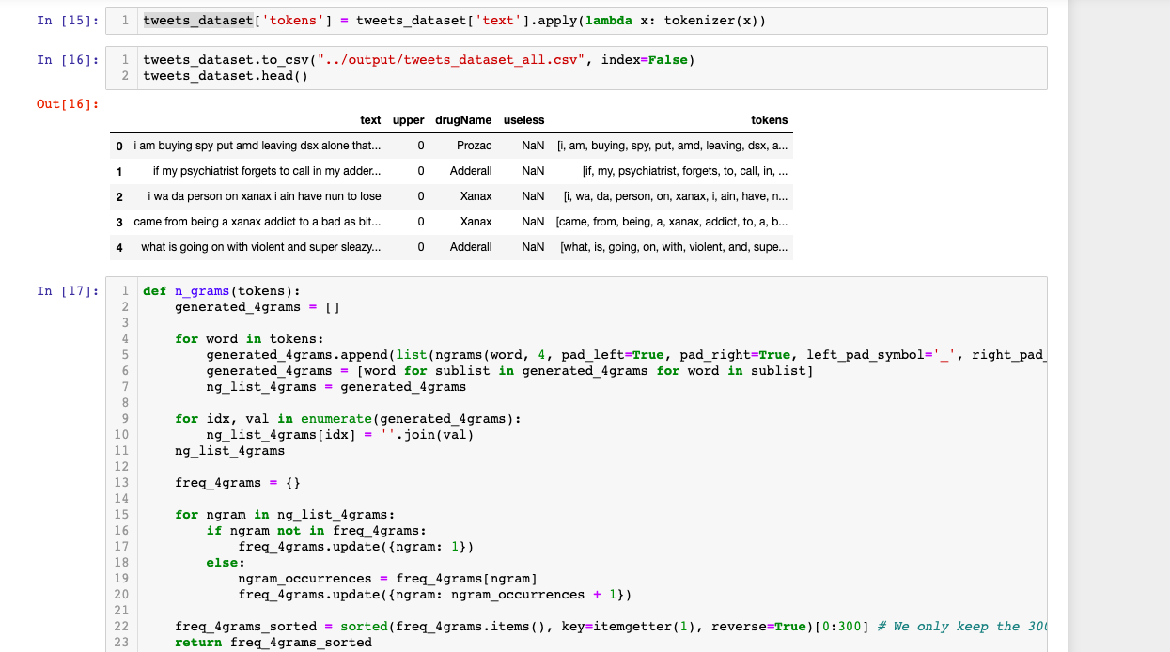

Slide 14
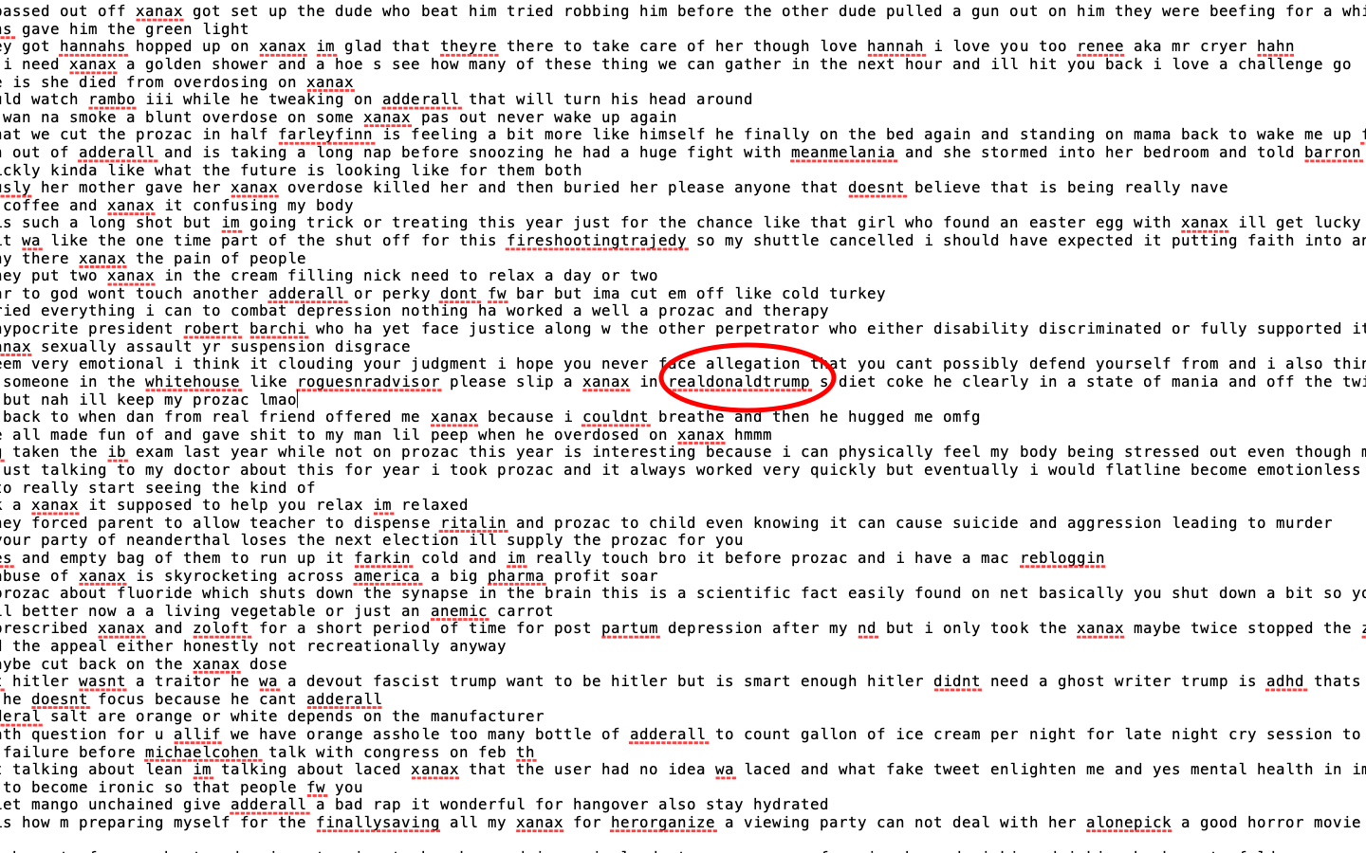

Slide 15
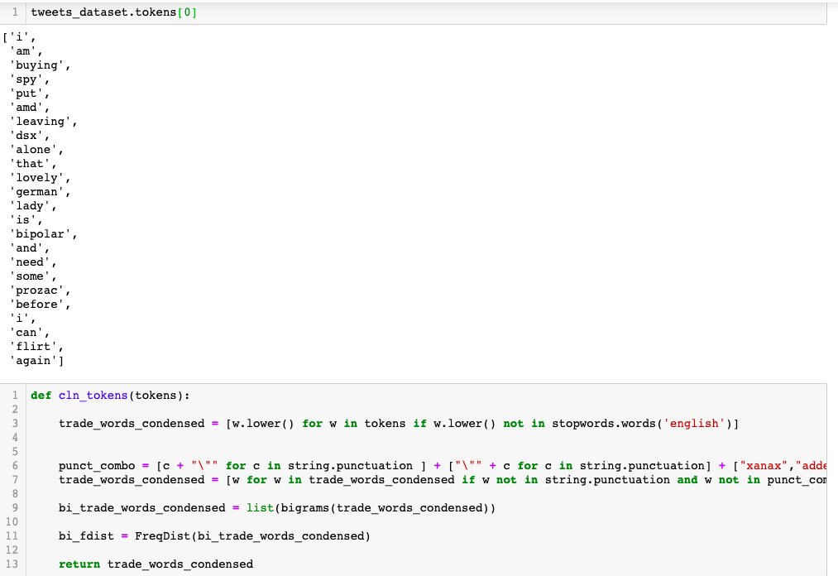

Slide 16
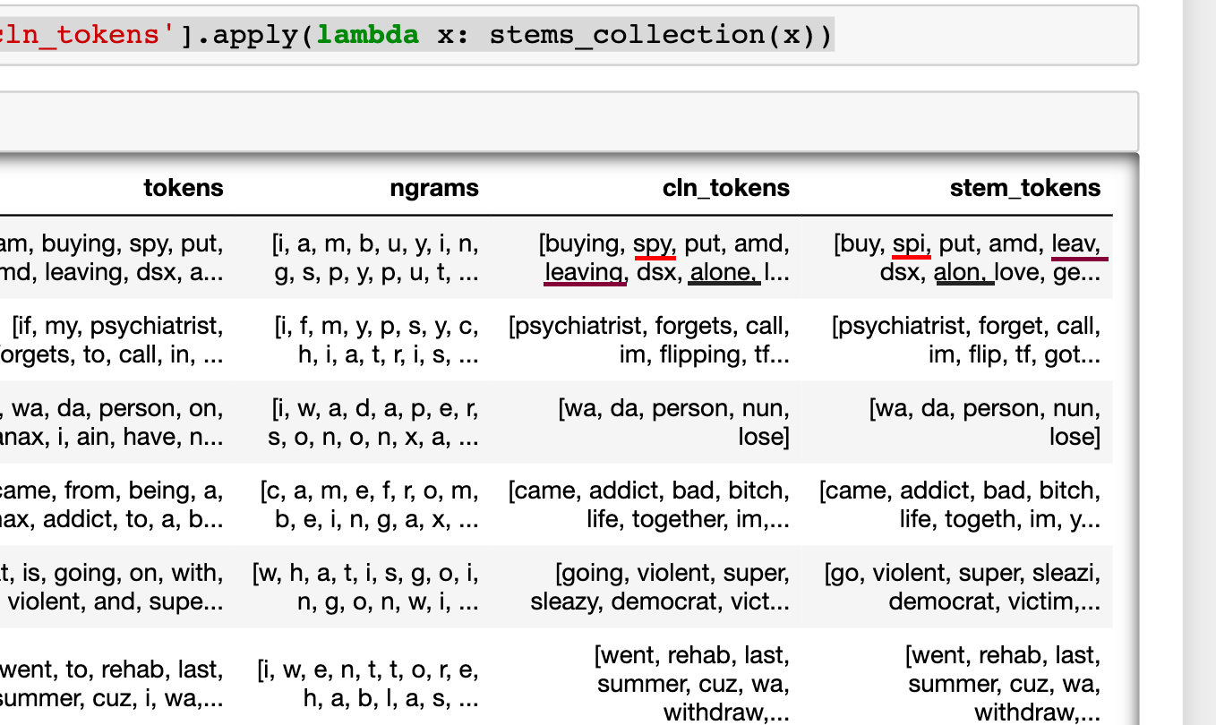

Slide 17
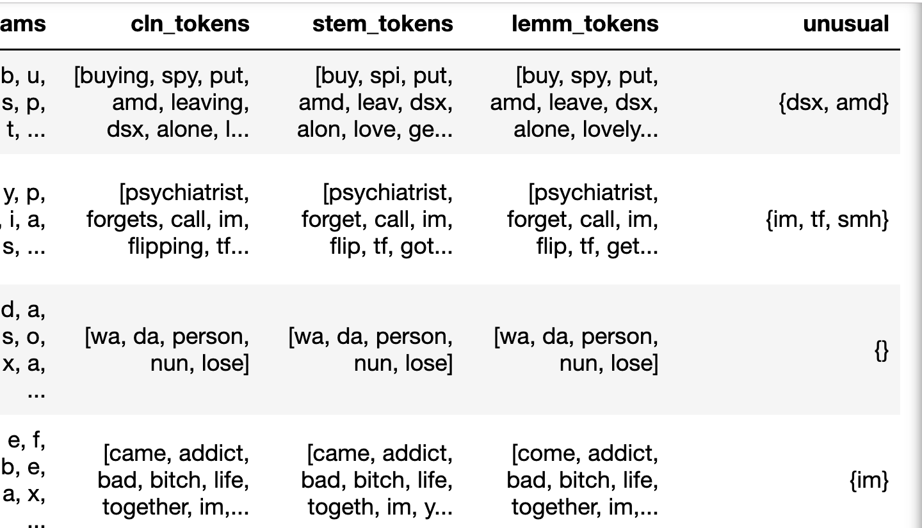

Slide 18
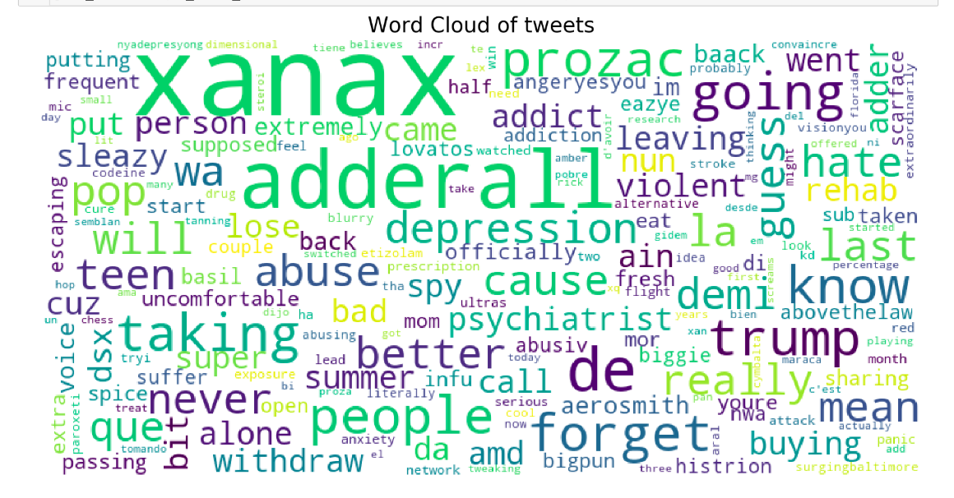

Slide 19
Word2vec
Convert word to vectors
Easy to compute synonym
Will use Google News dataset (about 100 billion words). The model contains 300-dimensional vectors for 3 million words and phrases.

Slide 20
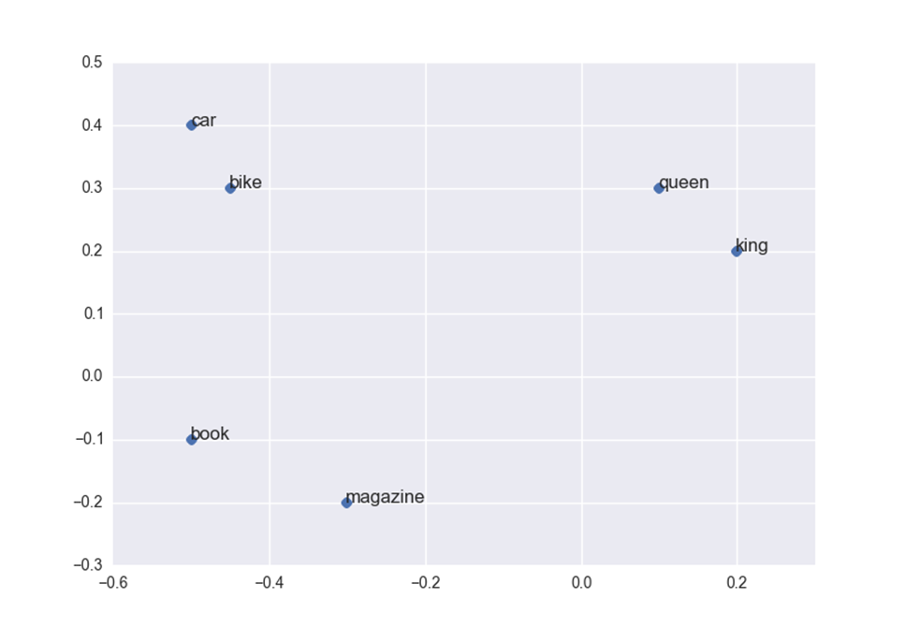

Slide 21
jaccard similarity
Group the similar ADRs
Compute the frequency
Comparison with other ADRs

Slide 22
Results
Our system will compute ADRs with frequency.
Higher frequency ADRs should match with Known ADRs of drug.

Slide 23
References
[1] Felix Gräßer, Surya Kallumadi, Hagen Malberg, and Sebastian Zaunseder. 2018. Aspect-Based Sentiment Analysis of Drug Reviews Applying Cross-Domain and Cross-Data Learning. DH '18 Proceedings of the 2018 International Conference on Digital Health. 121-125
http://kdd.cs.ksu.edu/Publications/Student/kallumadi2018aspect.pdf
[2] T. Al-Moslmi, N. Omar, S. Abdullah, and M. Albared. 2017. Approaches to CrossDomain Sentiment Analysis: A Systematic Literature Review. IEEE Access 5 (2017), 16173–16192. https://doi.org/10.1109/ACCESS.2017.2690342
[3] Diana Cavalcanti and Ricardo Prudêncio. 2017. Aspect-Based Opinion Mining in Drug Reviews. In Progress in Artificial Intelligence, Eugénio Oliveira, João Gama, Zita Vale, and Henrique Lopes Cardoso (Eds.). Springer International Publishing, Cham, 815–827.
[4] World Health Organization(WHO) https://www.who.int/
[5] Adverse drug reaction (ADR) https://en.wikipedia.org/wiki/Adverse_drug_reaction
[6] https://code.google.com/archive/p/word2vec

